Slide 1
Graph Convolutional Networks (GCN): convolution on graphs

Slide 2

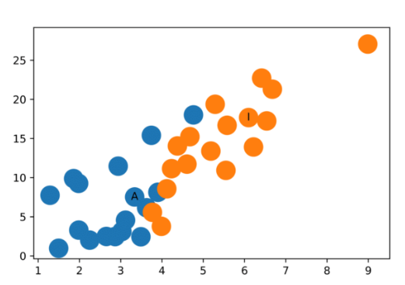
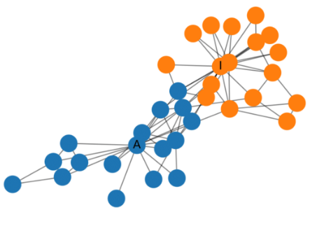
Convolution and graphs
General application of CNN
Input data is represented as a matrix
The cell itself represents a data, but also the relationship among the cells is relevant
The matrix contains information in both formats:
Cell
Locality between cells
Two cells are close if they are adjacent
References
Simple implementation
More detailed explanation
Application on classification
MNIST classification
Deep learning on graphs
Graph Convolutional Network (GCN)
Locality is studied considering the network. Semi-supervised learning algorithm.
Unsupervised step (starting from random weights): given information about the matrix (eg: adjacency matrix), nodes are clustered by providing different weights. No training in this step.
Then train with the labeled data
Application example: image classification.
Convolution in networking? No application until now.
Problem in networking: representation is with graphs, so locality should be represented in a different way.
Homophily: connected nodes tend to be similar
GCN

Slide 3
Motivation
Locality in a graph is relevant
Also in networking problem
Locality deepness is an hyperparameter of the network itself
Adaptability to variable input size
Algorithm must be adapted
It considers the problem of network topology and routing problem in a different way as GNN, but tries to solve the same problem
Keeps all advantages of the other techniques.
Adjacency matrix is easy to obtain
Analysis on other characteristics of the graph topology can be done to further improve the algorithm

